Slide 1
INDUSTRIAL HUMAN RESOURCE GEO-VISUALIZATION SWETHA C

Slide 2
Agenda
Problem Statement
Objective
Tools
Approach
EDA(exploratory Data Analysis)
Main Workers Vs Marginal Workers
Marginal Workers Rural Vs Urban
Top 10 Workers By Nic Name
Geo-visualization
Conclusion

Slide 3
Industrial Classification Importance: Understanding the distribution of the labor force across various sectors in India is crucial for assessing the country's economic landscape. Main and Marginal Workers: The classification of main workers and marginal workers, excluding cultivators and agricultural laborers, is significant for analyzing employment trends and economic status. Sex-Based Classification: The classification is based on gender, providing insights into the workforce composition by sex. Section, Division, and Class: Further classification based on sections, divisions, and classes provides detailed insights into the workforce's structure and distribution.
PROBLEM STATEMENT

Slide 4
OBJECTIVE
The primary aim of the study is to update and provide accurate information on the industrial classification of main and marginal workers to facilitate policy-making and employment planning effectively.
TOOLS
Python as the programming language.
Streamlit for web application.
Pandas for data manipulation.
Matplotlib for data visualization

Slide 5
EDA(EXPLORATORY DATA ANALYSIS)
Data Loading: Load the dataset containing state-wise counts of industrial classification of main and marginal workers.
Data Inspection: Inspect the dataset to understand its structure, including the number of rows and columns, data types, and any missing values.
Summary Statistics: Compute summary statistics for numerical variables such as mean, median, standard deviation, minimum, and maximum. This provides an overview of the distribution of the data.
Data Visualization: Create visualizations to explore the data distribution and relationships between variables.
Missing Values: Identify and handle missing values in the dataset. Determine if missing values are random or systematic and decide on appropriate strategies for imputation or removal.

Slide 6
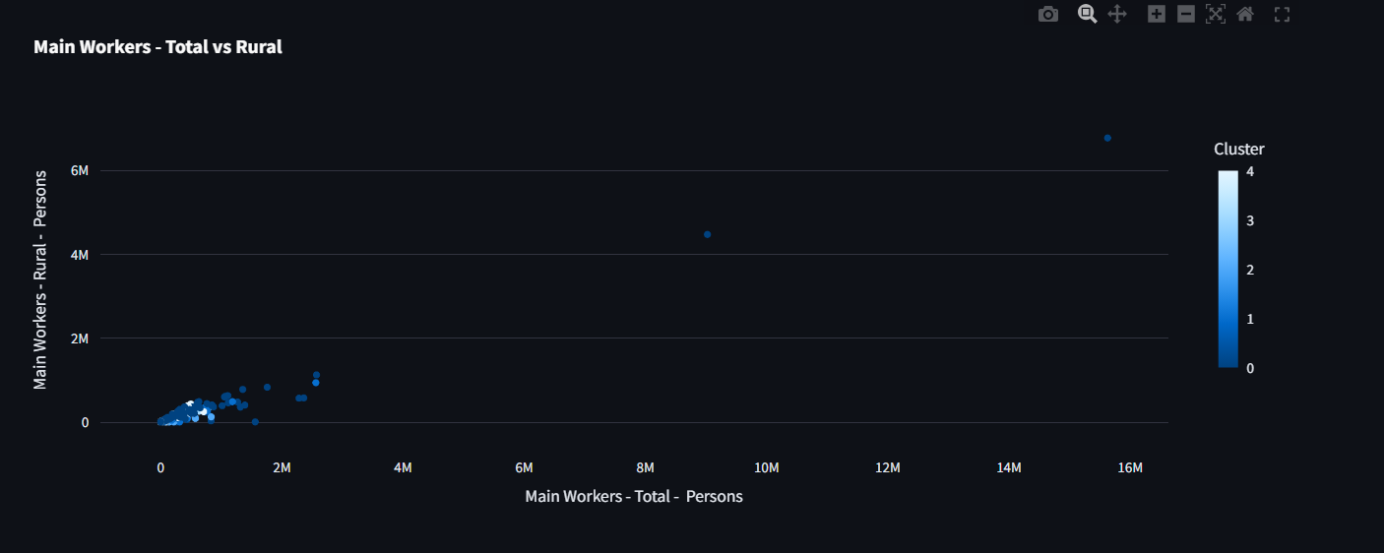
MAIN WORKERS-RURAL vs TOTAL PERSONS

Slide 7
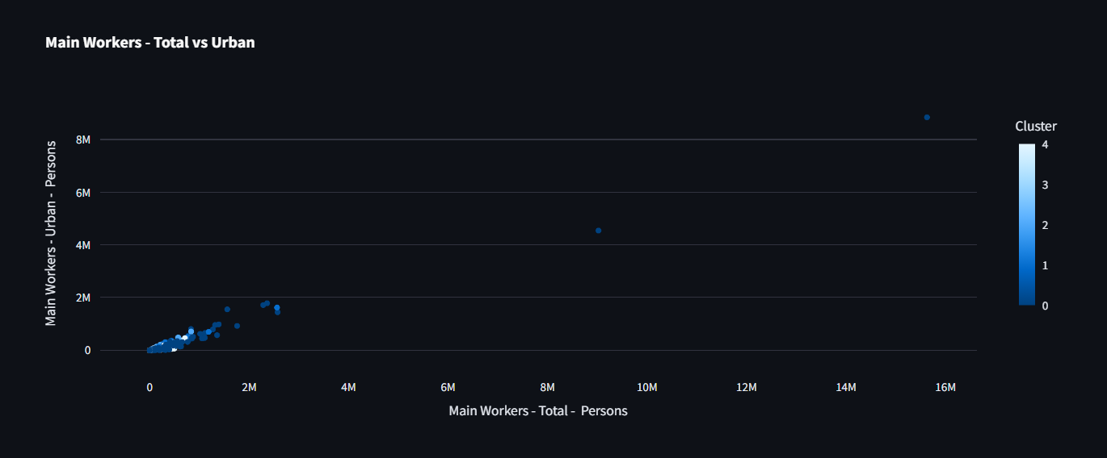
MAIN WORKERS-URBAN vs TOTAL PERSONS

Slide 8
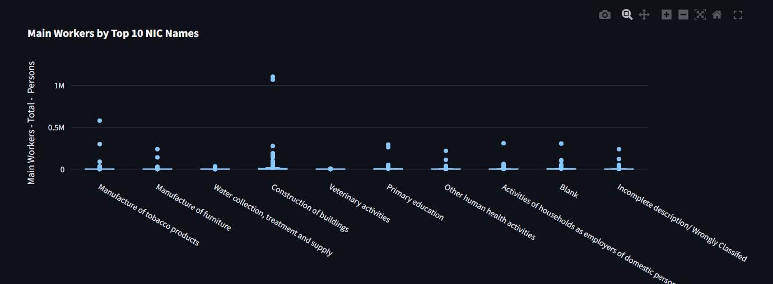
MAIN WORKERS BY TOP 10 NIC NAMES

Slide 9
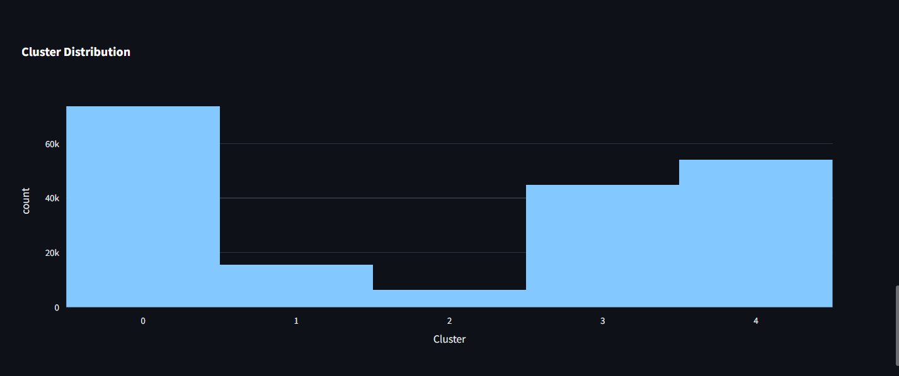
CLUSTER DISTRIBUTION

Slide 10
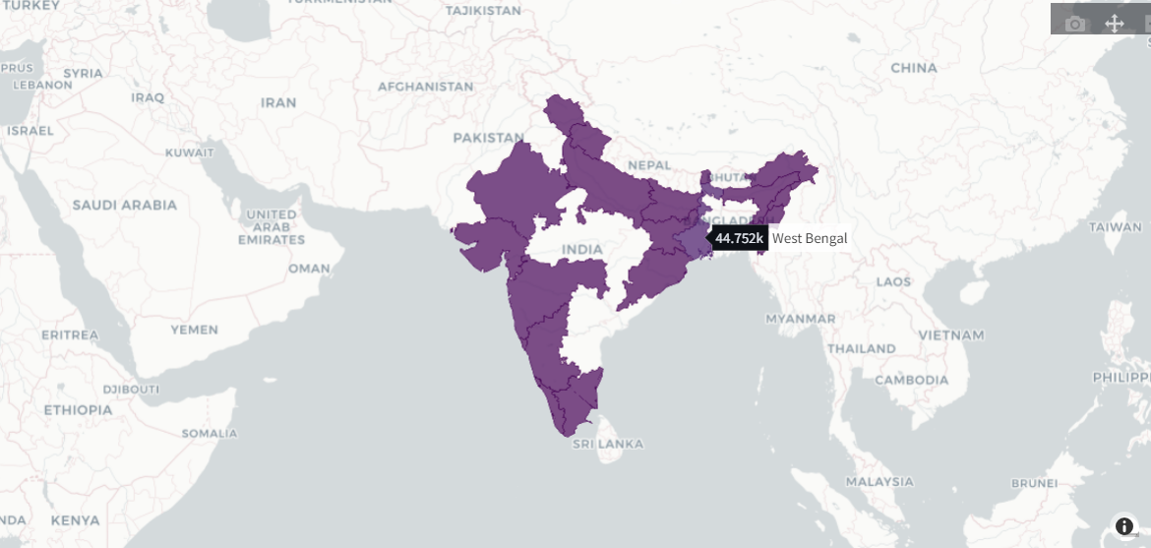
GEO-MAP VISUALIZATION

Slide 11
THANK YOU!

